Slide 1
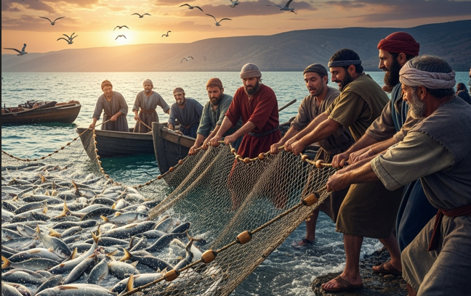
Net Worth: Working Together in Obedience to Christ
Luke 5:1–11

Slide 2
Luke 5:1-11 (NAS)
¹ Now it happened that while the crowd was pressing around Him and listening to the word of God, He was standing by the lake of Gennesaret; ² and He saw two boats lying at the edge of the lake;

Slide 3
Luke 5:1-11 (NAS)
but the fishermen had gotten out of them and were washing their nets. ³ And He got into one of the boats, which was Simon's, and asked him to put out a little distance from the land. And He sat down and continued teaching the crowds from the boat.

Slide 4
Luke 5:1-11 (NAS)
⁴ Now when He had finished speaking, He said to Simon, "Put out into the deep water and let down your nets for a catch." ⁵ Simon responded and said, "Master, we worked hard all night and caught nothing, but I will do as You say and let down the nets."

Slide 5
Luke 5:1-11 (NAS)
⁶ And when they had done this, they caught a great quantity of fish, and their nets began to tear; ⁷ so they signaled to their partners in the other boat to come and help them. And they came and filled both of the boats, to the point that they were sinking.

Slide 6
Luke 5:1-11 (NAS)
⁸ But when Simon Peter saw this, he fell down at Jesus' knees, saying, "Go away from me, Lord, for I am a sinful man!" ⁹ For amazement had seized him and all his companions because of the catch of fish which they had taken;

Slide 7
Luke 5:1-11 (NAS)
¹⁰ and likewise also were James and John, sons of Zebedee, who were partners with Simon. And Jesus said to Simon, "Do not fear; from now on you will be catching people." ¹¹ When they had brought their boats to land, they left everything and followed Him.

Slide 8
What the bible teaches:
The Call to Obedience Despite Past Failure
The Blessing of Shared Burden
The Humbling Power of Divine Partnership
The Commitment to Follow Together

Slide 9
Luke 5:1-11 (NAS)
¹ Now it happened that while the crowd was pressing around Him and listening to the word of God, He was standing by the lake of Gennesaret;

Slide 10
Luke 5:1-11 (NAS)
² and He saw two boats lying at the edge of the lake; but the fishermen had gotten out of them and were washing their nets.

Slide 11
Luke 5:1-11 (NAS)
³ And He got into one of the boats, which was Simon's, and asked him to put out a little distance from the land. And He sat down and continued teaching the crowds from the boat.

Slide 12
Luke 5:1-11 (NAS)
⁴ Now when He had finished speaking, He said to Simon, "Put out into the deep water and let down your nets for a catch." ⁵ Simon responded and said, "Master, we worked hard all night and caught nothing, but I will do as You say and let down the nets."

Slide 13
Luke 5:1-11 (NAS)
⁶ And when they had done this, they caught a great quantity of fish, and their nets began to tear; ⁷ so they signaled to their partners in the other boat to come and help them. And they came and filled both of the boats, to the point that they were sinking.

Slide 14
Ephesians 4:16 (NLT)
From whom the whole body fitly joined together and compacted by that which every joint supplieth, according to the effectual working in the measure of every part, maketh increase of the body unto the edifying of itself in love.

Slide 15
Luke 5:1-11 (NAS)
⁸ But when Simon Peter saw this, he fell down at Jesus' knees, saying, "Go away from me, Lord, for I am a sinful man!" ⁹ For amazement had seized him and all his companions because of the catch of fish which they had taken;

Slide 16
Luke 5:1-11 (NAS)
¹⁰ and likewise also were James and John, sons of Zebedee, who were partners with Simon. And Jesus said to Simon, "Do not fear; from now on you will be catching people."

Slide 17
Luke 5:1-11 (NAS)
¹¹ When they had brought their boats to land, they left everything and followed Him.

Slide 18
I Peter 4:10 (KJV)
As every man hath received the gift, even so minister the same one to another, as good stewards of the manifold grace of God.

Slide 19
Philippians 2:2 (KJV)
Fulfil ye my joy, that ye be likeminded, having the same love, being of one accord, of one mind.

Slide 20
Philippians 2:13 (NLT)
For God is working in you, giving you the desire and the power to do what pleases him.

Slide 21

…that Christ died for our sins according to the scriptures;
And that he was buried, and that he rose again the third day according to the scriptures:

Slide 22
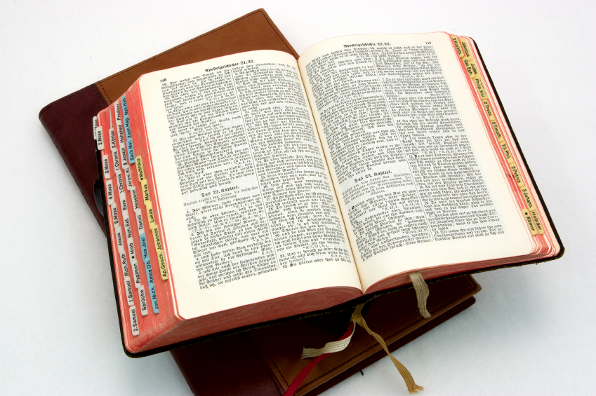
Hear: Romans 10:17
So then faith cometh by hearing, and hearing by the word of God.

Slide 23
Believe: Hebrews 11:6
But without faith it is impossible to please him: for he that cometh to God must believe that he is, and that he is a rewarder of them that diligently seek him.

Slide 24
Repent: Luke 13:3
I tell you, Nay: but, except ye repent, ye shall all likewise perish.

Slide 25
Confess: Matthew 10:32-33
32 Whosoever therefore shall confess me before men, him will I confess also before my Father which is in heaven.
33 But whosoever shall deny me before men, him will I also deny before my Father which is in heaven.

Slide 26
Baptize: Acts 22:16
And now why tarriest thou? arise, and be baptized, and wash away thy sins, calling on the name of the Lord.

